Slide 1
PREDICTING TAXI FARE AMOUNTS USING
MACHINE LEARNING SUBTITLE: ANALYZING KEY FACTORS THAT INFLUENCE TAXI FARES IN NYC

Slide 2
INTRODUCTION
Project Goal:
Predict taxi fares based on trip characteristics such as distance, time, and traffic conditions.
Why This Matters:
Understanding fare patterns can help improve pricing strategies and support drivers in optimizing their income. Data Source:
The analysis is based on a large dataset of real-world taxi
trips, including various trip-related features.

Slide 3
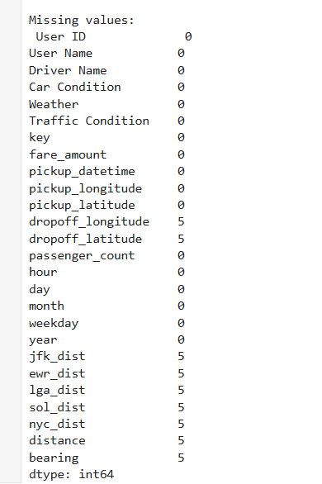

Preprocessing phase:
Checking for nulls and duplicates:

Slide 4
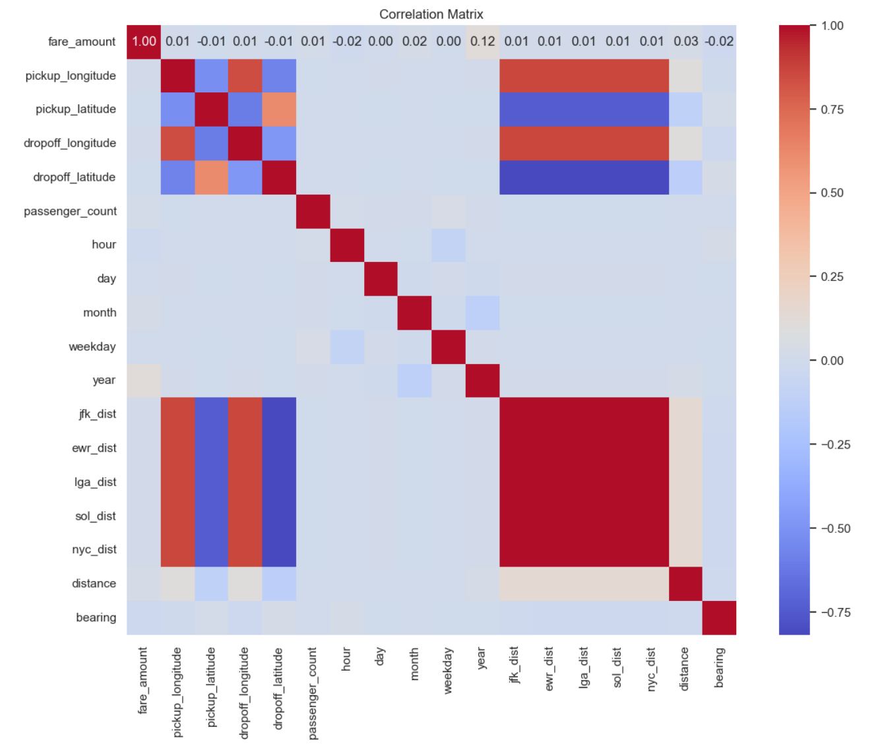
Correlation matrix before preprocessing

Slide 5
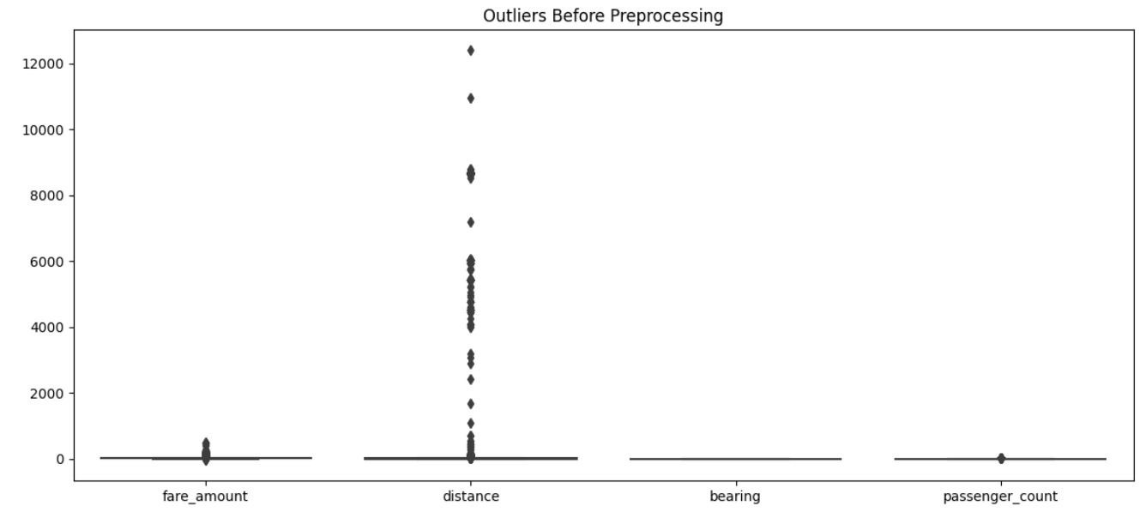
Checking for outliers:

Slide 6
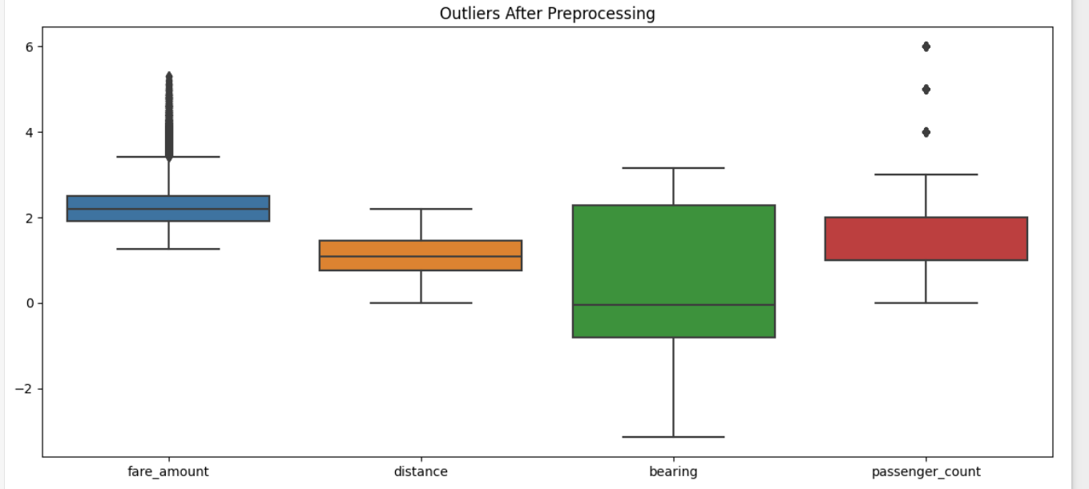
Outliers after handling using z core method

Slide 7
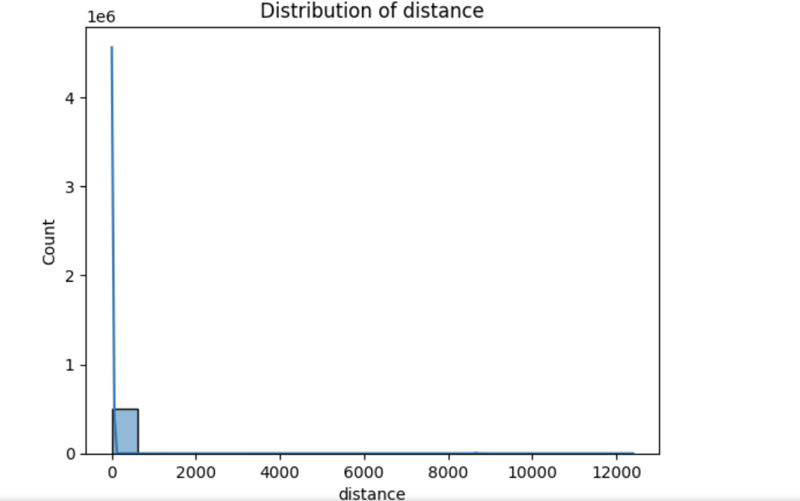
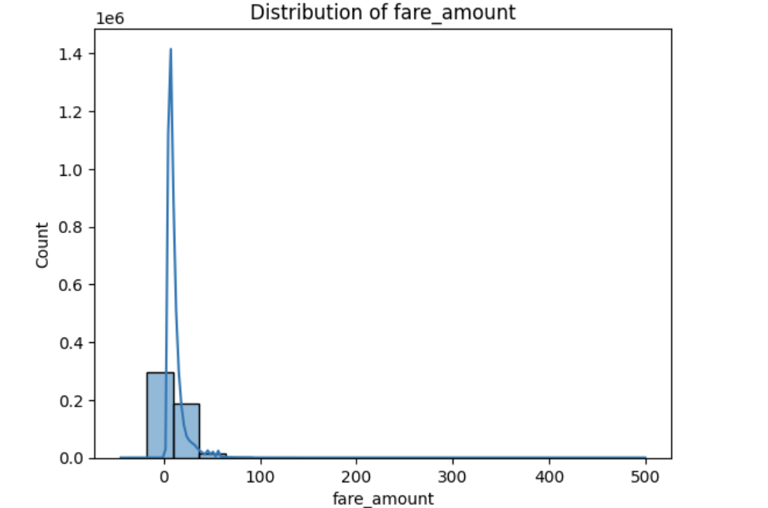
NUMERIC FEATURES DISTRIBUTION
We selected all numeric columns and plotted their distributions using histograms This helps us understand the spread and skewness of each feature.

Slide 8
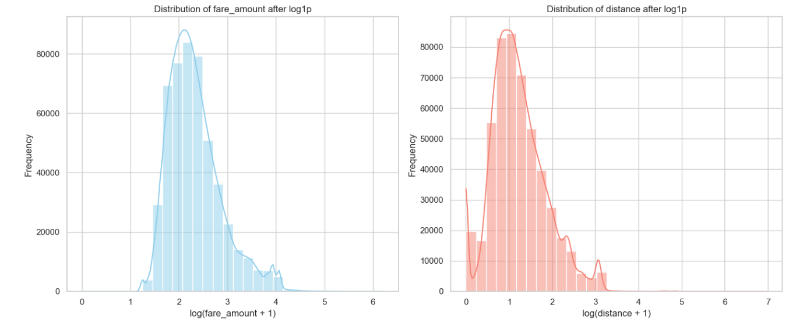
Fare amount and Distance distribution after applying log transformation method

Slide 9
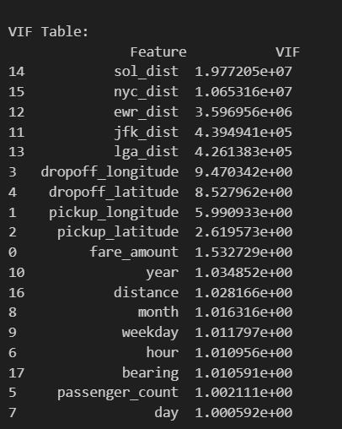
MULTICOLLINEARITY CHECK USING VIF
VIF values were computed for each feature.
Features with very high VIF (typically above 10) were removed to
reduce redundancy.
This improves the model's performance and stability by avoiding duplicated information.

Slide 10
Applying pca to the features with high multicollinearity
Columns used: ['jfk_dist', 'lga_dist', 'ewr_dist', 'nyc_dist', 'sol_dist’]
This pipeline applies PCA with n_components=1 to reduce the five airport distance features into a single principal component after imputing missing values with the mean. It simplifies the data and reduces multicollinearity while retaining the most significant variance.

Slide 11
FEATURE AND TARGET SELECTION
We selected the most relevant features that could influence the taxi fare Selected Features and dropped irrelevant columns :
Dropped columns: ['pickup_longitude', 'pickup_latitude', 'dropoff_longitude', 'dropoff_latitude','User ID', 'User Name', 'Driver Name','pickup_datetime','key’]

Slide 12
MODEL BUILDING USING PIPELINE
Built a Pipeline to streamline preprocessing and model training in one step.
Used:
preprocessor: for scaling and encoding data.
XGboost: as the prediction model.

Slide 13
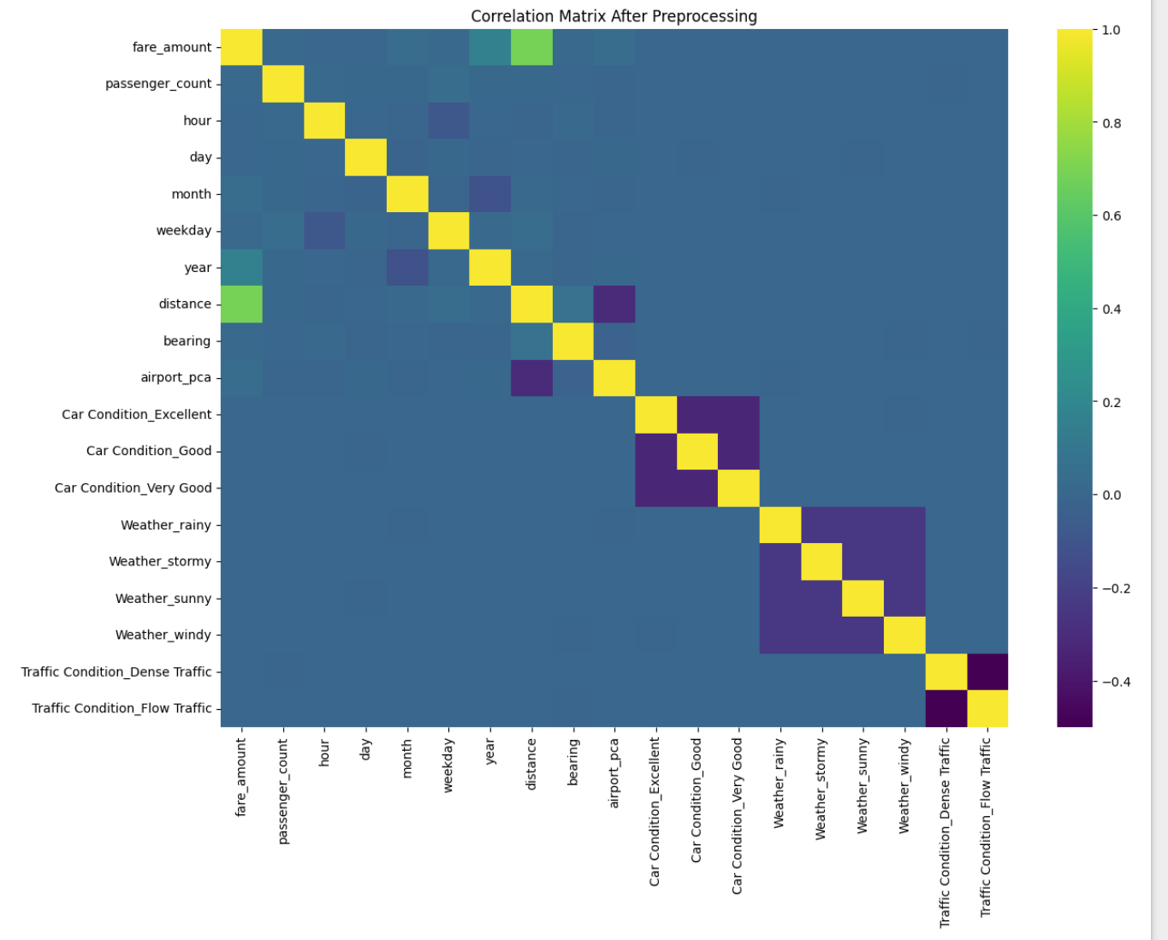
Correlation matrix after preprocessing and applying one hot encoding to the categorical features

Slide 14
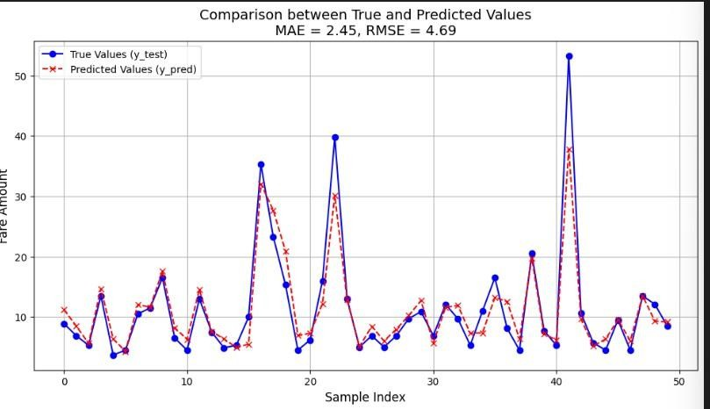
MODEL PREDICTION VS ACTUAL
Blue Line: True Values
Red Dashed Line: Predicted Values
The model performs well with slight deviations.

Slide 15
MODEL EVALUATION RESULTS
Xgboost when z score set to 2.5:
RMSE: 0.07
R²: 0.78
XGBoost when z score set to 3.0 :
RMSE: 0.23
R²: 0.82
The R² score of 0.82 means that 82% of the variance in the target
variable is explained by the XGBoost model.
Higher R² indicates a better fit between the predicted and actual values.

Slide 16
THANK YOU

